Slide 1
Introduction to Multimedia

Slide 2
Table of Content
Definition of multimedia
Classification of media types
Characteristics of multimedia system
Benefits of using multimedia
Problems with multimedia
Sectors that use multimedia
Multimedia products
Evaluation of multimedia products

Slide 3


What is multimedia?
The word multimedia is composed of two parts: the prefix multi and media.
Multi = Plural, more than 1, many
Media = Medium of communication

Slide 4
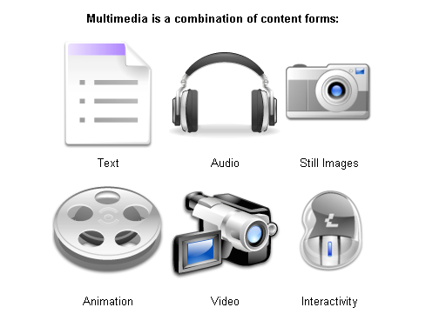
What is multimedia?

Slide 5
What is multimedia?
Definition:
Multimedia is the presentation of a computer application
incorporating media elements such as text, graphics, animations,
audio, and video.

Slide 6
Classification of media types
Time/Space nature
Sound
Video
Animation
Continuous
or time-based
Photo
Text
Graphics
Discrete
or space-based
Origin
Captured
from real world
Synthesized
by computer

Slide 7
Captured Versus Synthesized Media
Captured media refers to information types captured from the real world (e.g. Still pictures, moving pictures, and sound).
Synthesized media refers to information types synthesized by the computers (e.g. Text, graphics and computer animation).

Slide 8
Discrete Versus Continuous Media
Discrete media refers to media involving space dimension only (e.g. Still images, text and graphics). Discrete media is also referred to as static media or non-time-based media or non-temporal media or space-based media.
Continuous (time based) media refers to time-based media (e.g. Sound, moving images, and animation). Continuous media is also referred to as dynamic media or time-based media or temporal media.

Slide 9
Multi-sensory system
According to Dr. Albert Mehrabian, a specialist in interpersonal communication at the University of California, says:
Multimedia allows for seeing, hearing and doing (multi-sensory system)
  People recall 20% of what they see
  40% of what they see & hear
  70% of what they see, hear & do

Slide 10
Characteristics of Multimedia System
They must be computer-controlled.
User is able to view, hear, and see using a Multimedia
PC System.
They are integrated.
At least one discrete and one continuous media
combined for information presentation and sharing.

Slide 11
…continued
The information they handle must be represented
digitally.
Consists of various form of media i.e. text, graphics,
audio, video, and animations; created, stored, processed,
and transmitted DIGITALLY.
The interface to the final user may permit interactivity.
User is able to navigate, interact, create, and
communicate.

Slide 12
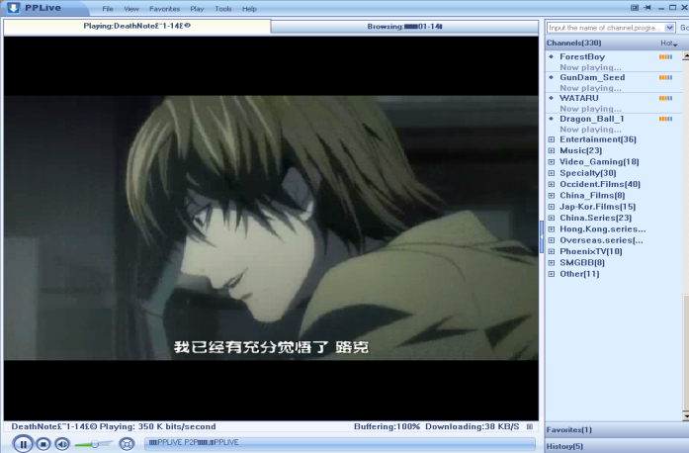
Benefits of using multimedia in software
Ease of use
  User friendly, increase user’s effectiveness
Intuitive Interface
  Allows user to determine functions of an application by their
  own intuition
Immersive Experience
- Software application takes over the entire computer screen,
allows user to focus on application

Slide 13
Benefits of using multimedia in software
Self-paced interaction & better retention
- allows information processing at one’s own pace
Better understanding
- simultaneous presentation of different media provides richer & broader range of information.
Cost effectiveness
- less training, less technical support

Slide 14
Problems with Multimedia
Investment costs
- multimedia involves high volume of content
- expensive copyright and royalty
Technical barriers (accessibility issues)
- upgrade IT & PC infrastructure
Sociopsychological barriers
  - Generation gap
  - Learning rates
  - Learning in group/individual
  - Importance of teacher
Legal problems
  - Copyright

Slide 15

Where to use multimedia ?
Business
Government
Education
Broadcasting & Entertainment
Research & Development
Health

Slide 16

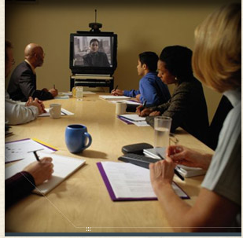
Business
Interactive Multimedia Merchandising
  Online-shopping Kiosks
  Virtual shopping / home shopping
  http://www.thevirtualmall.co.uk/
Desktop Videoconferencing
  Due to the high cost of transportation and the large amount of employee time spent traveling to meetings, videoconferencing is on the rise.

Slide 17
…continued
Multimedia Travel Systems
  These systems enable the travel agents to show their customers about where they will travel, what will be their accommodation like, and what they will be able to do at their destinations.
  www.visitmalaysia.com.my
Real Estate
  Multimedia systems enable buyers to visit hundreds of properties virtually, view on screen photos of homes, inspect floor plans, see street maps, and study neighborhood demographics.
  www.penangtimessquare.com

Slide 18
…continued
Corporate Training
  Many corporations have used multimedia to reduce training cost and improve employee productivity.
Advertising and Electronics Brochures
  The electronic brochure is an advertising and marketing tool that usually consists of single diskette or CD-ROM sent to targeted audiences. Corporations are also beginning to offer shareholders annual reports on CD-ROM.
www.porsche.com

Slide 19
Government
Public Service Kiosks
  Multimedia kiosks convey public service information such as jobs and employment opportunities.
  City-info kiosks offer to citizens and travelers the ability to find information on addresses, points of interest, shops, restaurants, public transportation, hours of opening, guided tours, city transport info.

Slide 20
…continued
Politics
  Multimedia in general and internet in particular are playing a big role in politics and virtual campaigning where every political candidate contesting in an election has a web site.
Consumer Information
  Multimedia based CD-ROMs are available which
  contains government information on a wide variety of
  topics: government forms, list of government offices in
  each state, tax preparation etc.

Slide 21

Education
Computer Aided Learning
To assist student through simulation for better understanding such as volcano eruption, corrosion, language pronunciation, etc.
www.quiz-tree.com
Virtual Campus
Learning takes place in a virtual classroom using video conferencing and online lecture so that students all around the world can attend.

Slide 22
Broadcasting and Entertainment
Electronic catalogue
Product features and descriptions are advertised through web, CD and mobile devices.
Interactive Movie
Viewers can decide the direction of the plot of the movie and camera angle.
On-demand News or movies
News, movies and TV series can be watched on demand through web and mobile devices.
http://soccernet.espn.go.com

Slide 23

…continued
3D or animated movies
Movies created through advance 3D technology and animation techniques.
Video Games
Advances in the field of multimedia have led to more attractive video and computer games being available now in the consumer market.

Slide 24
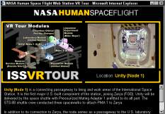
…continued
Virtual Reality
Virtual Reality refers to the use of a computer to immerse the user into a simulated experience that it seems real. Virtual reality systems often use special hardware to enhance the experience, including visual displays.
Cyber Sports
Cyber Sports is the use of virtual reality to provide computer users with a realistic sports experience. Two new interactive virtual reality devices let you “Swing” and “Hit” balls at your PC.

Slide 25

Medicine
Virtual Surgery
Virtual surgery authoring system has been created for producing surgical training simulation.
Surgeons can use 3-D images created from magnetic resonance imaging (MRI) scans of the human body to practice complicated procedures such as brain tumor removal and reconstructive surgery.

Slide 26
…continued
Video Conferencing and Image Retrieval
The use of imaging techniques (X-Rays, CT, MRI etc) is growing in health care. The collection, maintenance, processing and distribution of these records can be significantly improved by using computer based storage and multimedia networking. Once these records are integrated with the on-line patient information and easily shared by both local and remote physicians, it results in a large number of benefits like reduced cost and improved care.

Slide 27
Multimedia Products
Briefing
eg: corporate presentation, sales presentation and educational lectures.
Reference
eg: encyclopedias, dictionaries
Database
eg: library system, phone directory

Slide 28
…continued
Education and Training
eg: - Instructor support products – Resource materials
for instructors
  - Standalone or self-paced products – Learning
  materials for students
  to study at their own
  pace
Kiosk
eg: bank machines, mall information centers.
Entertainment and Games
eg: computer games and movies.

Slide 29
Evaluating Multimedia Products
Evaluation can be done from two perspectives:
User’s Perspective
Subject and Content
Platform
Usability
Cost
Developer’s Perspective
Content
Performance
Delivery
Interface

Slide 30
User’s perspective
Subject/content
Area of interest
Entertainment value – multimedia games and sports-related products
Education, training or learning objectives – how-to and subject-related products
Need for information – encyclopedia or similar reference products

Slide 31
…continued
Platform (hardware and software)
Focus on what type of equipment the user has and if it is compatible with a specific product.
Criteria for evaluation:
  Hardware platforms
  Computer processor speed and data bus requirements
  Memory sizing

Slide 32
…continued
Usability
Usability means that the user can apply, learn, use the program efficiently.
The key criteria here are:
  Learning/training time: how long does it take to learn how to use the product,
  Error rate: how often mistakes made by the users and how severe is the mistake?,
  Task Time: how long does it take to accomplish a task,
  Retention: how difficult is for the user to operate and how attractive is the product to use.

Slide 33


…continued
Cost
The cost can be the first or the last factor considered by many people. Generally, users are willing to spend depending on how much is gained.

Slide 34
Developer’s perspective
Developer must evaluate and aim to improve their product better than the last.
From the developer’s perspective, evaluation will cover:
  - Content
  - Performance
  - Delivery
  - Interface

Slide 35
Developer’s perspective
Content
Product domain or subject matter- is the material useful for the end user?
Message – How does the product communicate the information? Will the users understand it?
Comparison to comparable products

Slide 36
…continued
Performance
Developer must consider that general users have equipment that has much less capabilities, so products should always be tested on a range of platforms before they are released.
Graphic, audio and video presentation should be use wisely not to slow down the application for slower machine.

Slide 37
…continued
Delivery
Delivery means how fast user is able to use the product depending on the speed of the installation procedure, the configuration and documentation.
The instructions should be straightforward, easy to configure and documentation are thorough and adequate.

Slide 38
…continued
Interface
Ease-of-use for novice users
Depth for experienced or expert users
Navigation features all work and are all useful and user-friendly

Slide 39
Enabling Technologies
The main reason for increasing popularity of multimedia lies in dramatic concurrent advances in some enabling technologies
  Higher processing power
  More memory capacity
  Bigger storage capacity
  Better compression technology
  Carrier and transmission technology
  Input and output device technology
  Protocol technology
  Database technology
  Software technology

Slide 40
Summary
Multimedia is the presentation of a computer application incorporating
media elements such as text, graphics, animations, audio, and video.
There are 4 groups of media types: discrete, continuous, captured,
synthesized.
The characteristics of multimedia system are:
- They must be computer controlled.
- They are integrated.
- The information handled must be represented digitally.
- The interface to the final user may permit interactivity.
Benefits of using multimedia: ease of use, intuitive interface, immersive
experience, self-paced interaction & better retention, better understanding,
cost effectiveness.

Slide 41
Summary
Problems with multimedia: investment cost, technical barriers,
sociopsychological barriers, legal problems.
Sectors that use multimedia: Business, Government, Education,
Broadcasting & Entertainment, Research & Development, Health.
Multimedia products: Briefing, Reference, Database, Education and training, Kiosk, Entertainment and games.
Multimedia products can be evaluated from 2 perspectives:
user’s perspective, developer’s perspective.

